Slide 1
FINAL ASSESMENT
SAI SRI SURYA SNEHITH YANDAMURI
4300

Slide 2
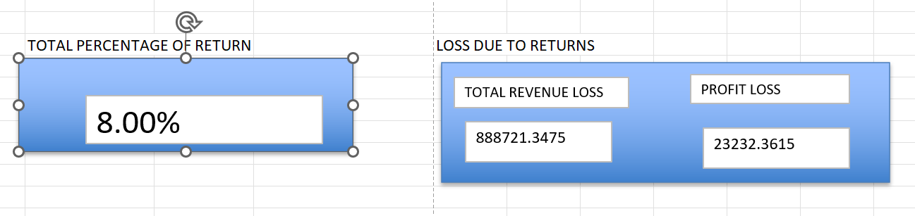
QUESTION-1
FORMULA :
PIVOT TABLE
RETURN | Count of Order ID2 | Count of Order ID | Sum of Profit | Sum of TOTAL_AMOUNT
NO | 92.00% | 9194 | 263164.6602 | 10599340.72
Yes | 8.00% | 800 | 23232.3615 | 888721.3475
Grand Total | 100.00% | 9994 | 286397.0217 | 11488062.07
INFERENCE:
8 percent orders were returned
With the loss shown

Slide 3
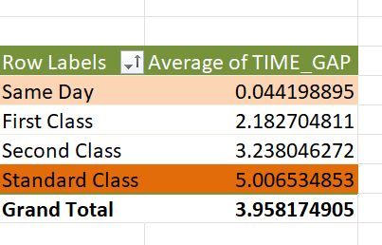
QUESTION-2
FORMULA :
Pivot table
INFERENCE:
Same day: is the fastest
Standard class is the slowest

Slide 4
QUESTION-3
FORMULA :
Pivot table
INFERENCE:
highest sum of sales is for furniture and chairs in it

Slide 5
QUESTION-4
FORMULA :
Pivot table
INFERENCE:
highest sum of sales is for furniture and chairs in it

Slide 6
QUESTION-5
FORMULA :
Find the sum of sales and sum of profit
INFERENCE:
Based on the region we got the sales and profit

Slide 7
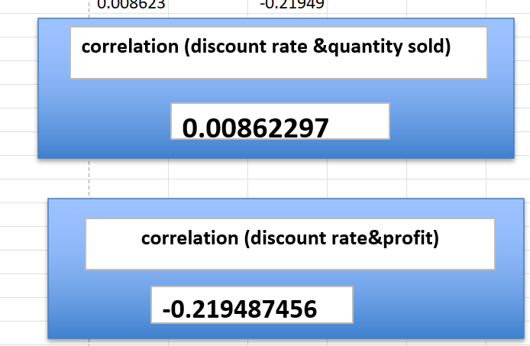
QUESTION-6
FORMULA :
=CORREL(Orders!T2:T9995,Orders!S2:S9995)
=CORREL(Orders!T2:T9995,Orders!U2:U9995)
INFERENCE:

Slide 8
QUESTION-7
FORMULA :
Pivot table and bar graph
INFERENCE:
South is having the least sales
It has the highest potential to grow .needed to increase the sales of office supplies
So that it can be used to increase the furniture sales

Slide 9
QUESTION-8
FORMULA :
Pivot table comparing the count of orders in the last 4 years
INFERENCE:
TOTAL_customers who orderd more than 25 in last 4 year is 29

Slide 10
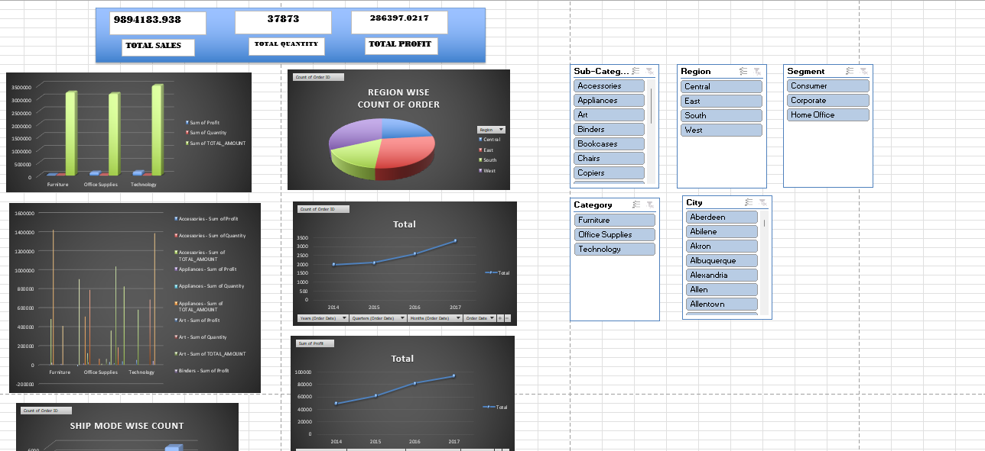
QUESTION-9

